Slide 1
You will also find that there are some duplicates of certain slides. This is on-purpose and allows the presentation to be used in a number of different settings:
In-person
Sent by email
Printed
Depending on your intended use, you can delete the other slides as needed, including this one.
Thank you!
professional
equity assessment report Template
Thanks for downloading the Professional Equity Assessment Report (PEAR) template. In this file, you will find an editable PowerPoint presentation that you can present to your clients.
This is an editable PowerPoint presentation that you can present to your clients. It includes many different options so you can personalize it to your brand. Swap out logos, images and input the seller’s name and address to really tailor it to your prospects.
YOUR WEBSITE URL

Slide 2
PROFESSIONAL
EQUITY ASSESSMENT REPORT
Client Name
Client Address

Slide 3
WHAT IS A PROFESSIONAL
EQUITY ASSESSMENT REPORT?
A Professional Equity Assessment Report (PEAR) is a custom evaluation
of your home’s cash value. By knowing what you currently owe on your mortgage and estimating the value of your home, we can determine your home’s approximate equity. This is a powerful tool to help you make confident decisions in your home- selling process.

Slide 4
Estimated Home Value
Name of Client
$550,000
Client’s Address
Your home’s professional equity assessment report
Mortgage Balance
$150,000
Let’s take a look at the numbers to see how much equity you have in your home.
Equity Estimate
$400,000
YOUR WEBSITE URL

Slide 5
Let’s talk Next steps
I’m sure you have questions.
I'd love to talk with you about your equity estimate and discuss next steps in your home-selling process.
Your Name
Your Title
Your Brokerage
Your Email
Your Phone Number
+62 123 456 789
INSERT YOUR PHOTO
YOUR WEBSITE URL

Slide 6
YOUR LOGO
Let’s talk
Next steps
Your Name
Your Title
Your Brokerage
Your Email
Your Phone Number
+62 123 456 789
YOUR WEBSITE URL

Slide 7
YOUR LOGO
Let’s talk
Next steps
+62 123 456 789
YOUR WEBSITE URL

Slide 8
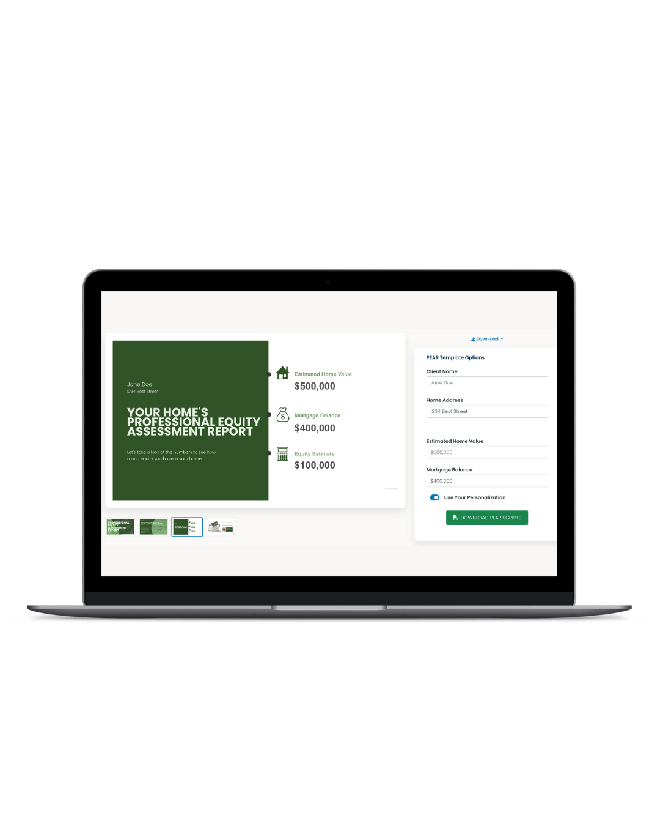
www.keepingcurrentmatters.com
THANK YOU
We hope you enjoy your Professional Equity Assessment Report template. You can get more real estate marketing resources, including an interactive version of this tool, by signing up for a 14-day free trial at TryKCM.com
LEARN MORE

